Slide 1
Unsupervised Opinion Summarization with Noising and Denoising
Reinald Kim Amplayo and Mirella Lapata
ILCC, School of Informatics, University of Edinburgh
ACL 2020

Slide 2
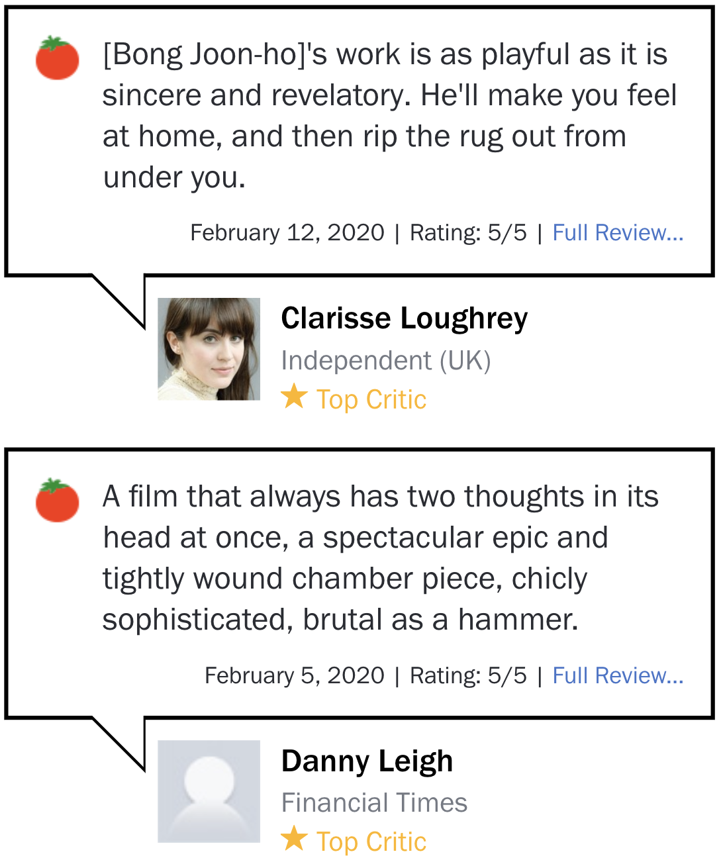
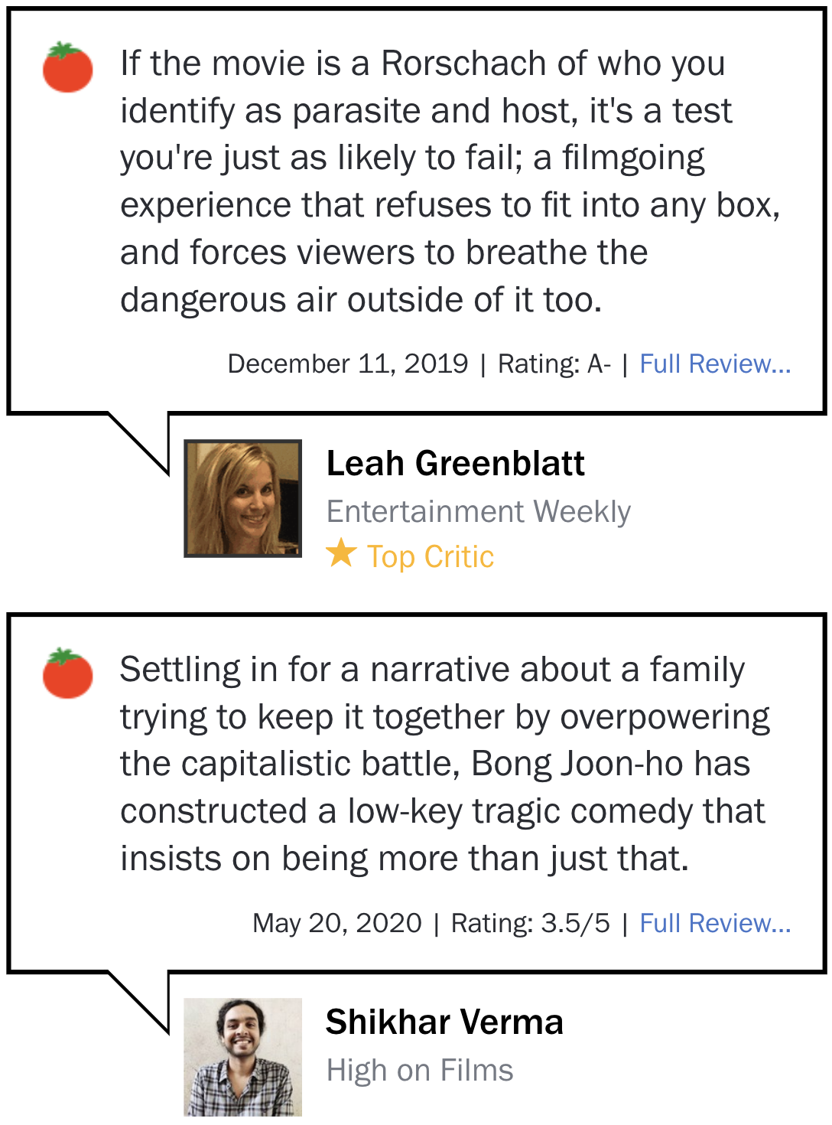
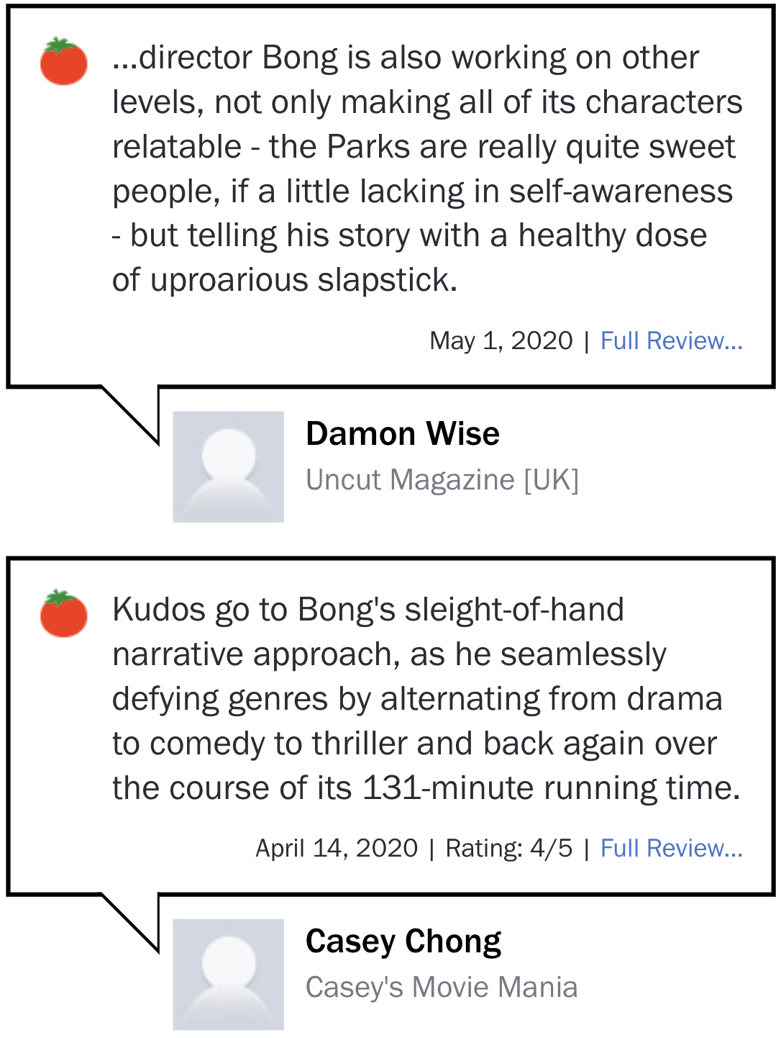
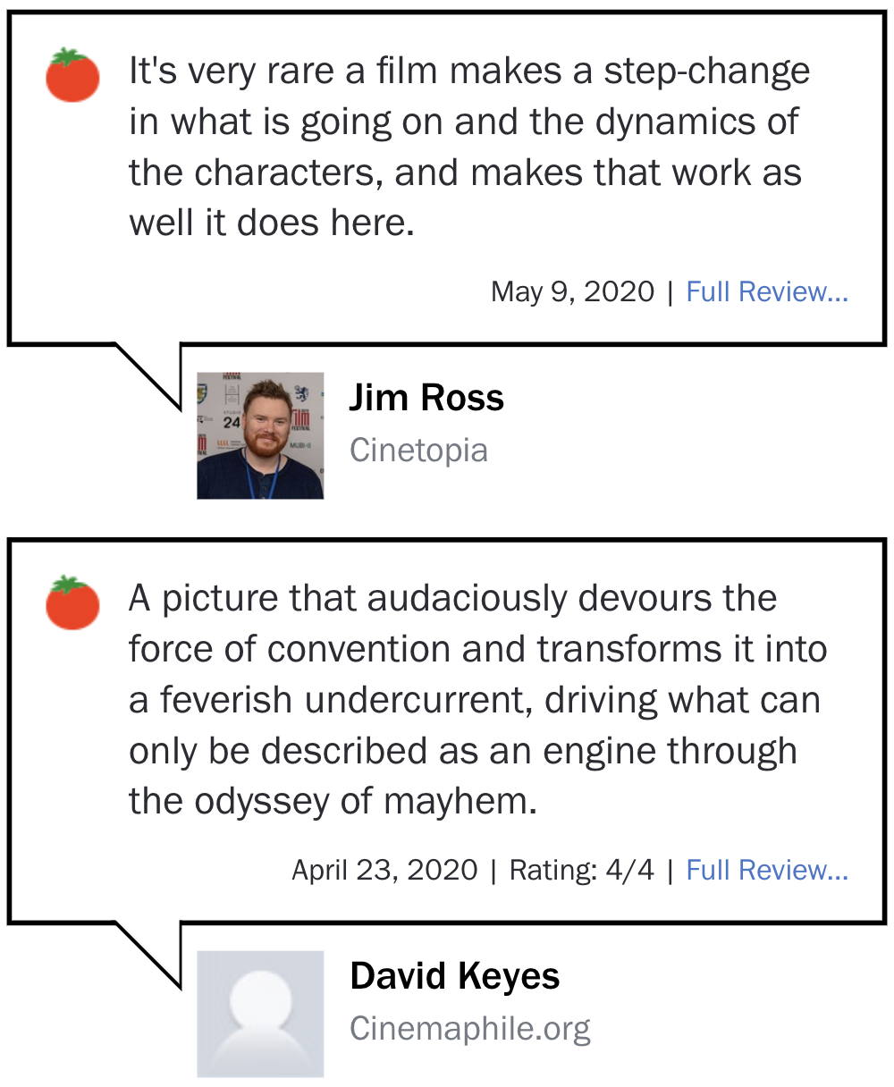
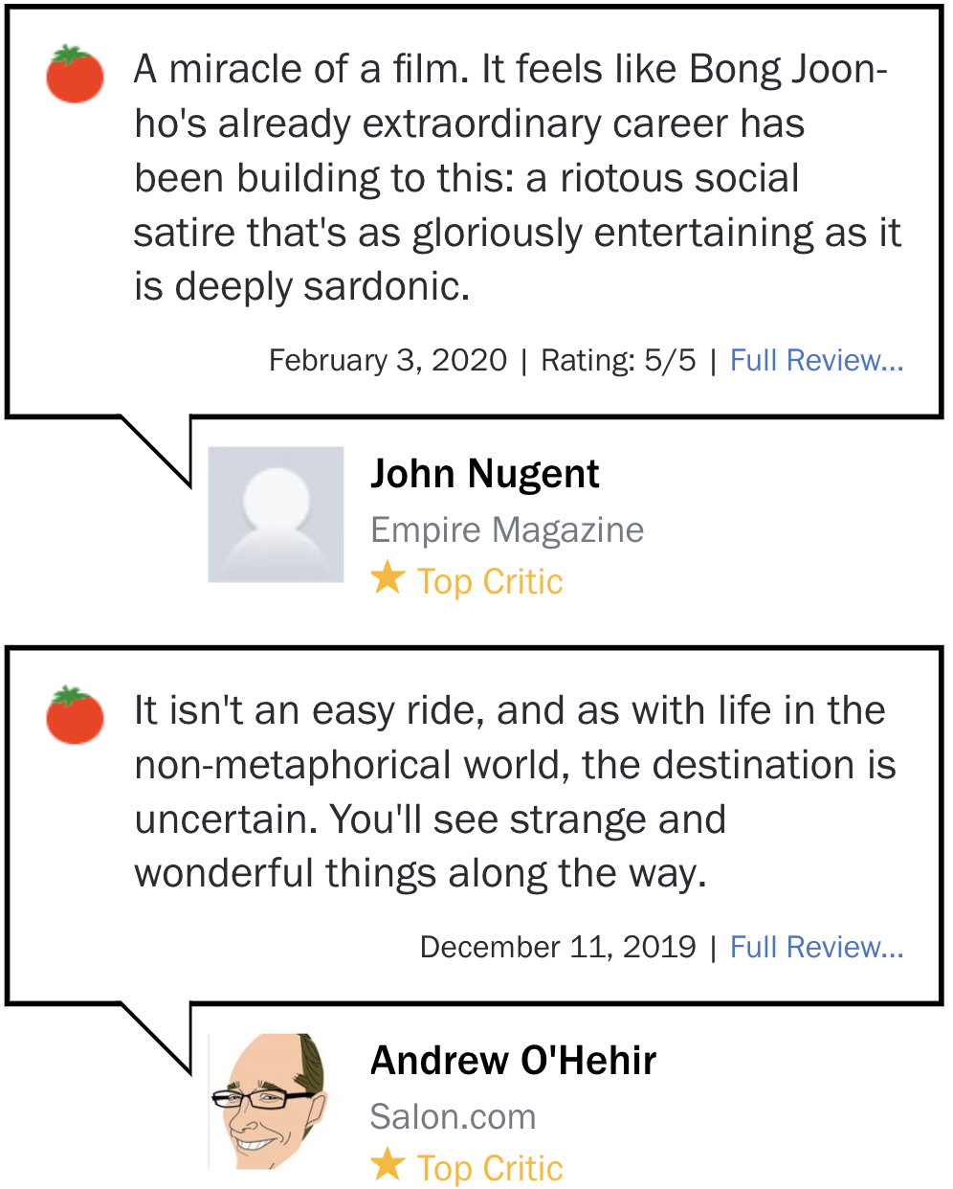




Opinion Summarization
You read reviews about the movie
You want to watch a movie
… and more reviews
… and 400 more reviews!
…to decide whether to watch it or not
Let’s watch!
Meh…

Slide 3


Opinion Summarization
and a set of reviews as input…
Given an entity…
…
…automatically produce an opinion summary
Let’s watch!
Meh…
so that people can make decisions

Slide 4
Supervised Opinion Summarization
Summarization Model
Training loss

Slide 5
Supervised Opinion Summarization
Summarization Model
Training loss
Summaries may not be available at training time!
???

Slide 6
Unsupervised Opinion Summarization
Extractive approaches
Standard methods: LexRank (Erkan and Radev, 2004), Centroid (Radev et al., 2000), etc.
Abstractive approaches
Template- and graph-based methods (Ganesan et al., 2010, Di Fabbrizio et al., 2014)
MeanSum (Chu and Liu, 2019): neural-based method using an autoencoder
reconstructs the average of the review encodings as the summary
uses weak decoders (e.g., no attention and copy) to mitigate posterior collapse
See also Copycat (Brazinskas et al., ACL 2020), which additionally uses randomly sampled reviews to enable attention and copy

Slide 7
This Work
Neural-based, abstractive, and unsupervised
Approach: Noising and Denoising
Enables the use of supervised learning!
Summarizer is not limited to weak decoders!
Noising: Synthetic dataset creation
A backward simulation of how people write summaries
Introduces two linguistically motivated noising functions
Denoising: Opinion summarization

Slide 8

Noising and Denoising: Motivation
Burgers here are very delicious, but they were too expensive.
The waiter was rude to me. Too bad since the food was great…
Summarizer
= denoiser
The food here is delicious, especially the burger. The service is awful, and the staff is rude.
I did not like the food here, and so are the staffs! Not recommend.
Great ambience and amazing food. Will come back for sure.
food
Worst service ever! There is also no parking and the location is bad.
service
non-salient information
= noise

Slide 9
Noising and Denoising: Motivation
Review Corpus
Burgers here are very delicious, but they were too expensive.
The waiter was rude to me. Too bad since the food was great…
sample
Synthetic Dataset Creation
The food here is delicious, especially the burger. The service is awful, and the staff is rude.
I did not like the food here, and so are the staffs! Not recommend.
Great ambience and amazing food. Will come back for sure.
Pseudo-Summary
Worst service ever! There is also no parking and the location is bad.
noise
Pseudo-Reviews

Slide 10
Noising and Denoising: Motivation
Burgers here are very delicious, but they were too expensive.
The waiter was rude to me. Too bad since the food was great…
DenoiseSum
(our model)
The food here is delicious, especially the burger. The service is awful, and the staff is rude.
I did not like the food here, and so are the staffs! Not recommend.
Great ambience and amazing food. Will come back for sure.
Summary
Worst service ever! There is also no parking and the location is bad.
Reviews

Slide 11
Synthetic Dataset Creation
Candidate Summary
Summary Sampling
Filter out bad candidates using domain-specific constraints
Reviews with first-person pronouns, unnecessary symbols, etc.
the movie is a fun comedy with fine performances .
Token-level Noising
Chunk-level Noising
the film is a nice comedy
with stellar cast .
with good production and zohan ,
a nice comedy by the film .
PP
NP
CC
NP
,
NP
PP
NP
.
Document-level Noising
the high-handed premise does not always work in zohan but you have to admire the chutzpah in trying it .
0.05
the fine performance of sandler as zohan in this very funny comedy makes this movie special .
0.67
the latest in a long line of underwhelming adam sandler comedies .
0.12

Slide 12
Synthetic Dataset Creation
Candidate Summary
Segment Noising
Token-level noising replaces words using a bidirectional language model
Chunk-level noising removes, inserts, and rearranges chunks using a syntactic template
Document Noising
Selects reviews from the corpus with the highest lexical overlap
Using both allows aspect diversity amongst pseudo-reviews
the movie is a fun comedy with fine performances .
Creates reviews which may mention aspects not found in the summary
Token-level Noising
Chunk-level Noising
the film is a nice comedy
with stellar cast .
with good production and zohan ,
a nice comedy by the film .
PP
NP
CC
NP
,
NP
PP
NP
.
Document-level Noising
Creates reviews with content similar to the summary
the high-handed premise does not always work in zohan but you have to admire the chutzpah in trying it .
0.05
the fine performance of sandler as zohan in this very funny comedy makes this movie special .
0.67
the latest in a long line of underwhelming adam sandler comedies .
0.12

Slide 13
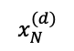
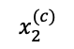
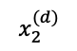
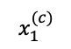
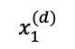
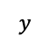
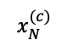
DenoiseSum: Denoising Summarization
(d) Partial Copy
Attention
Attention with Copy
(b) Denoising
$$x_{1}^{(c)}$$
+0.5,+0.3
$$x_{2}^{(c)}$$
-0.6,+0.8
(c) Noise-Specific Fusion
Input (Segment Noise)
...
...
...
...
$$x_{N}^{(c)}$$
-0.9,+0.2
Summary
Output
(a) Encoder
Decoder
$$y$$
$$x_{1}^{(d)}$$
+0.8,-0.1
$$x_{2}^{(d)}$$
Input (Document Noise)
-0.6,-0.8
(c) Noise-Specific Fusion
(e) Discriminator
...
...
...
...
Category Classifier
Category
$$x_{N}^{(d)}$$
-0.4,-0.2
Multi-Source Encoder
Encode each input review separately using BiLSTMs

Slide 14
DenoiseSum: Denoising Summarization
(d) Partial Copy
Attention
Attention with Copy
(b) Denoising
$$x_{1}^{(c)}$$
+0.5,+0.3
$$x_{2}^{(c)}$$
-0.6,+0.8
(c) Noise-Specific Fusion
Input (Segment Noise)
...
...
...
...
$$x_{N}^{(c)}$$
-0.9,+0.2
Summary
Output
(a) Encoder
Decoder
$$y$$
$$x_{1}^{(d)}$$
+0.8,-0.1
$$x_{2}^{(d)}$$
Input (Document Noise)
-0.6,-0.8
(c) Noise-Specific Fusion
(e) Discriminator
...
...
...
...
Category Classifier
Category
$$x_{N}^{(d)}$$
-0.4,-0.2
Explicit Denoising Module
Remove noise by correcting/adjusting the weights of the review encodings

Slide 15
DenoiseSum: Denoising Summarization
(d) Partial Copy
Attention
Attention with Copy
(b) Denoising
$$x_{1}^{(c)}$$
+0.5,+0.3
$$x_{2}^{(c)}$$
-0.6,+0.8
(c) Noise-Specific Fusion
Input (Segment Noise)
...
...
...
...
$$x_{N}^{(c)}$$
-0.9,+0.2
Summary
Output
(a) Encoder
Decoder
$$y$$
$$x_{1}^{(d)}$$
+0.8,-0.1
$$x_{2}^{(d)}$$
Input (Document Noise)
-0.6,-0.8
(c) Noise-Specific Fusion
(e) Discriminator
...
...
...
...
Category Classifier
Category
$$x_{N}^{(d)}$$
-0.4,-0.2
Noise-Specific Fusion
Fuse encodings by weight-summing encodings, specific to the type of noise

Slide 16
DenoiseSum: Denoising Summarization
(d) Partial Copy
Attention
Attention with Copy
(b) Denoising
$$x_{1}^{(c)}$$
+0.5,+0.3
$$x_{2}^{(c)}$$
-0.6,+0.8
(c) Noise-Specific Fusion
Input (Segment Noise)
...
...
...
...
$$x_{N}^{(c)}$$
-0.9,+0.2
Summary
Output
(a) Encoder
Decoder
$$y$$
$$x_{1}^{(d)}$$
+0.8,-0.1
$$x_{2}^{(d)}$$
Input (Document Noise)
-0.6,-0.8
(c) Noise-Specific Fusion
(e) Discriminator
...
...
...
...
Category Classifier
Category
$$x_{N}^{(d)}$$
-0.4,-0.2
Decoder with Partial Copy
Decode the summary using an LSTM with attention and copy, but do not copy from (ungrammatical) segment noisy inputs

Slide 17
DenoiseSum: Denoising Summarization
(d) Partial Copy
Attention
Attention with Copy
(b) Denoising
$$x_{1}^{(c)}$$
+0.5,+0.3
$$x_{2}^{(c)}$$
-0.6,+0.8
(c) Noise-Specific Fusion
Input (Segment Noise)
...
...
...
...
$$x_{N}^{(c)}$$
-0.9,+0.2
Summary
Output
(a) Encoder
Decoder
$$y$$
$$x_{1}^{(d)}$$
+0.8,-0.1
$$x_{2}^{(d)}$$
Input (Document Noise)
-0.6,-0.8
(c) Noise-Specific Fusion
(e) Discriminator
...
...
...
...
Category Classifier
Category
$$x_{N}^{(d)}$$
-0.4,-0.2
Training with Discriminative Loss
Directly optimize the denoising module by learning to classify the category of the summary

Slide 18
Experiments: Datasets
Dataset | Split | #entities | #reviews | #toks/entities | #toks/reviews
Rotten Tomatoes (movies) | No train
 | Dev | 536 | 98.0 | 23.5 | 23.6
 | Test | 737 | 100.3 | 23.6 | 23.8
Yelp (businesses) | No train
 | Dev | 100 | 8.0 | 70.3 | 70.9
 | Test | 100 | 8.0 | 67.8 | 67.3

Slide 19
Experiments: Datasets
Dataset | Split | #entities | #reviews | #toks/entities | #toks/reviews
Rotten Tomatoes (movies) | Synthetic Train | 25,000 | 40.0 | 28.4 | 22.7
 | Dev | 536 | 98.0 | 23.5 | 23.6
 | Test | 737 | 100.3 | 23.6 | 23.8
Yelp (businesses) | Synthetic Train | 100,000 | 8.0 | 72.3 | 64.8
 | Dev | 100 | 8.0 | 70.3 | 70.9
 | Test | 100 | 8.0 | 67.8 | 67.3

Slide 20
Experiments: Automatic Evaluation

Slide 21
Experiments: Human Evaluation
Best-Worst Scaling (Louviere et al., 2015)
SentiNeuron
MeanSum
DenoiseSum

Slide 22
Experiments: Human Evaluation
Summary Veridicality: Check whether the facts mentioned in the summary are indeed discussed in the input reviews.

Slide 23
Example Outputs
Gold: It isn’t quite the breath of fresh air that Iron Man was, but this sequel comes close with solid performances and an action-packed plot.
SentiNeuron: Flabby, disjointed, and eschewing conflict for extended scenes of improv clowning, it’s the superheroic equivalent of a rat pack film.
MeanSum: The movie has too many twists in its own way, but it’s a bit too busy.
DenoiseSum: Iron Man 2 isn’t as good as the first movie, but it is a fun and fascinating film.

Slide 24
Example Outputs
Gold: A dark dramedy with exceptional performances from Jennifer Aniston and Jake Gyllenhaal, The Good Girl is a moving and astute look at the passions of two troubled souls in a small town.
SentiNeuron: Even during the most intense moments, it’s hard to shake the impression that the conspicuously buff-and-polished Justine is only visiting this drab world, her miserable life an interesting career move.
MeanSum: Most of the time, the movie is a little too rare.
DenoiseSum: With good performances, direction and cast, The Good Girl is a provocative, intelligent and absorbing film.

Slide 25
Summary
Unsupervised opinion summarization using supervised techniques
Create synthetic review-summary pairs using noise generation functions
Treat opinion summarization as denoising the reviews, removing non-salient information
DenoiseSum: outperforms competitive systems by a wide margin

Slide 26
Thank you!
Code and dataset available:
https://github.com/rktamplayo/DenoiseSum

